Slide 1

Introduction to Silverlight
Radoslav Kirilov
National Academy for Software Development
academy.devbg.org

Slide 2

Contents
What is Silverlight?
Silverlight vs. Flash and Flex
Silverlight versions
Silverlight architecture
Silverlight and WPF
Installing Silverlight plug-in
Silverlight SDK and the Visual Studio Extensions

Slide 3
What is Silverlight?

Slide 4
What is Silverlight?
Silverlight is simply a web-based platform for building and running RIAs
  It’s a cross-platform, cross-browser platform
Silverlight enables the creation of rich applications
  Using a lightweight add-on
    Friendly to designers
    Friendly to developers

Slide 5
What is Silverlight? (2)
It supports playback video and audio files
Using XAML, HTML, and JavaScript, it delivers rich:
  Multimedia
  Vector graphics
  Animations
The Silverlight player itself is a completely standalone environment

Slide 6
Silverlight vs. Flash and Flex

Slide 7
Silverlight vs. Flash and Flex
The most successful browser plug-in is Adobe Flash
Difficult to integrate ASP.NET content and Flash content
  Different programming language (ActionScript)
  Different programming environment (Flex)

Slide 8
Silverlight vs. Flash and Flex (2)
Silverlight aims to give .NET developers a better option
  Provides a browser plug-in with many similar features to Flash
  Designed from the ground up for .NET
    Can write client-side code and server-side code in the same language
    Uses many of the same abstractions

Slide 9
Silverlight vs. Flash and Flex (3)
The Silverlight plug-in features include:
  Widespread browser support
  Lightweight
  2D Drawing
  Animation
  Media
  The CLR
  Web service interaction

Slide 10
Silverlight vs. Flash and Flex (4)
Shares common features with Flash
Has entirely new and even revolutionary features
Silverlight also includes relatively few ready-made controls

Slide 11
Silverlight Versions

Slide 12
Silverlight Versions
Silverlight 1.0
  Supports the JavaScript programming model
  We use JavaScript to interact with Silverlight objects
Silverlight 1.1
  Supports the .NET Framework
  We can use any Common Language Runtime

Slide 13
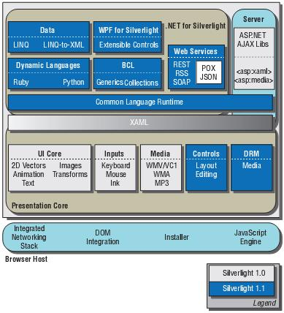
Silverlight Versions (2)
Compares Silverlight 1.0 and 2.0

Slide 14
Silverlight Architecture

Slide 15
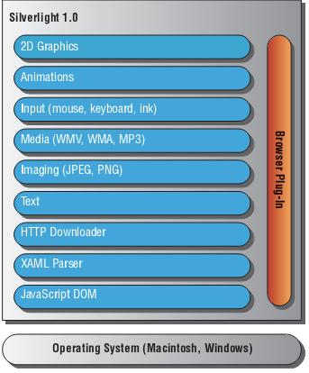
Silverlight Architecture
Silverlight from an architectural perspective

Slide 16
Silverlight Architecture (2)
Lightweight browser plug-in
  Has Windows and Macintosh modules
Native presentation runtime
  Rendering of XAML-based components in addition to the browser rendering of HTML
Interactive video and audio
  Video and audio are handled as a media element in XAML

Slide 17
Silverlight Architecture (3)
Programming layer
  Silverlight XAML is exposed using a DOM model to JavaScript
    AJAX programs using the same programming practices
      On the client
      On the server

Slide 18
Silverlight and WPF

Slide 19
Silverlight and WPF
Silverlight borrows the WPF model for designing user interfaces
We use XAML markup to define the user interface in both
In Silverlight we use elements that are also found in WPF
  Canvas layout container
  TextBlock and Image
  Shapes like the Rectangle, Ellipse, Line

Slide 20
Silverlight and WPF (2)
The animation model in Silverlight works like the WPF’s animation system
To show video or play audio files we use the MediaElement class in both

Slide 21
Installing Silverlight Plug-in

Slide 22
Installing Silverlight Plug-in
The Silverlight player is not installed automatically
You can download everything you need to get started with Silverlight from:
http://silverlight.net/GetStarted
Here’s what you’ll find:
  The Silverlight 2.0 runtime
  Silverlight Tools for Visual Studio 2008
  The Silverlight 2.0 Software Development Kit

Slide 23
Installing Silverlight Plug-in (2)
After the Silverlight player is installed you never have to install it again
Silverlight has built into it he knowledge of updates
If you install the Silverlight player you are shown the Welcome to Silverlight page
http://www.microsoft.com/silverlight/resources/install.aspx

Slide 24
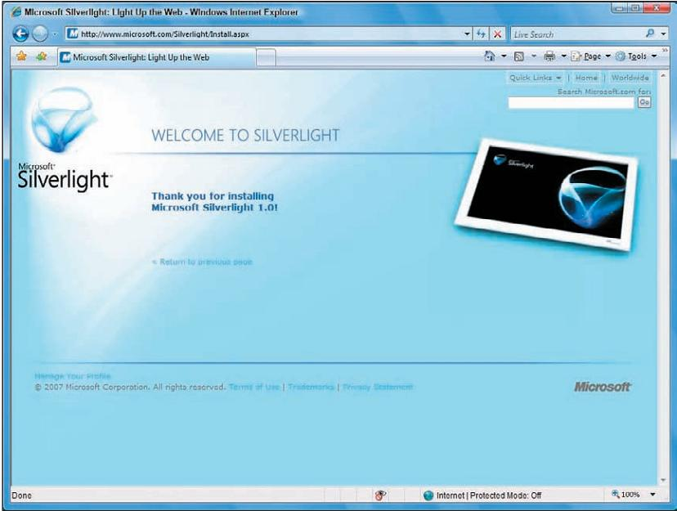
Installing Silverlight Plug-in (3)

Slide 25
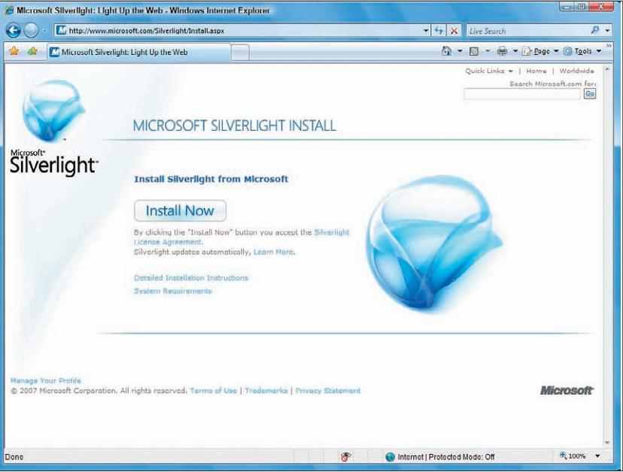
Installing Silverlight Plug-in (4)
The same page without installing Silverlight player

Slide 26
Visual Studio Extensions

Slide 27
Visual Studio Extensions
Provides developers with support for building applications
You could create a Silverlight page by hand
  It’s not easy
  Not worth the trouble
Use a design tool like
  Visual Studio
  Expression Blend

Slide 28
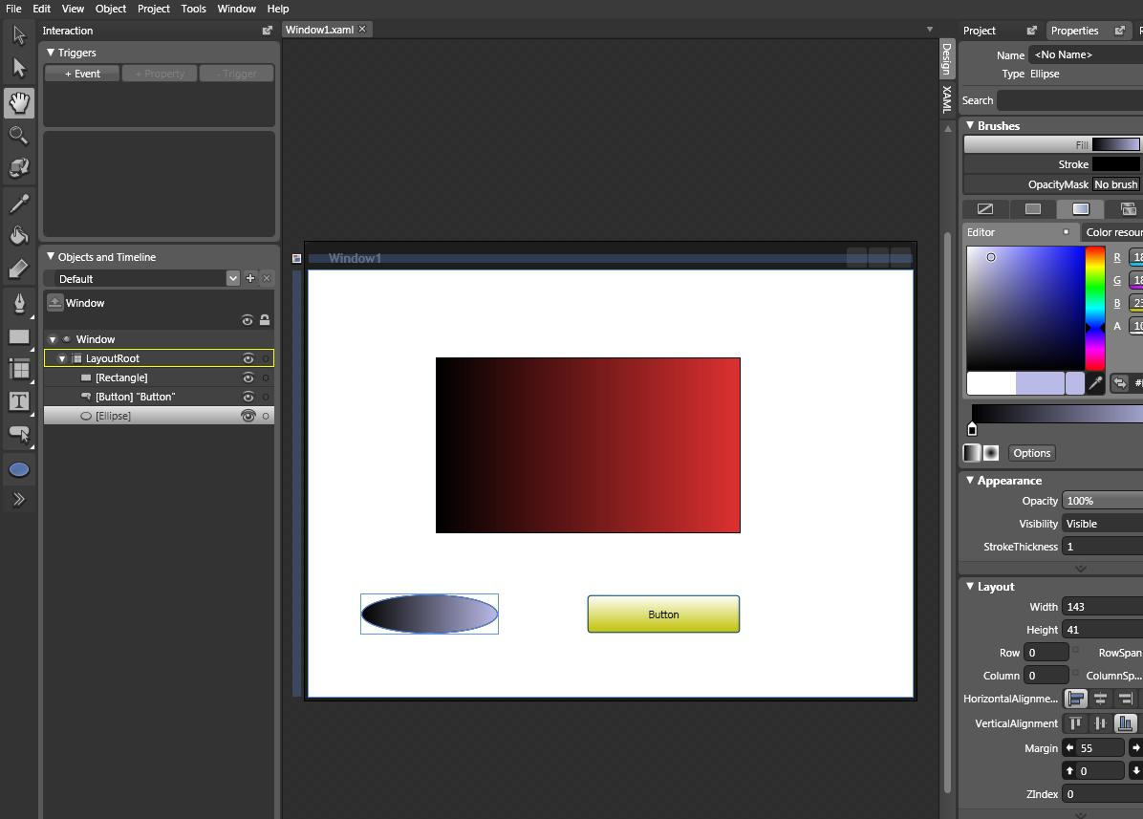
Visual Studio Extensions (2)
Expression Blend

Slide 29
Silverlight SDK

Slide 30
Silverlight SDK
The Silverlight Software Development Kit contains
  Documentation
  Online samples
  Quickstarts
  Tools

Slide 31
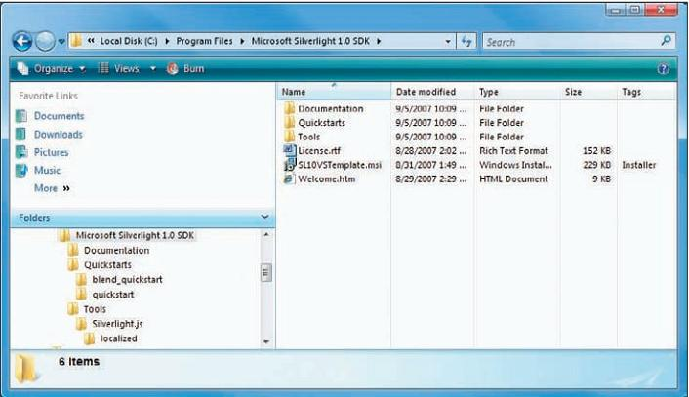
Silverlight SDK (2)
The folder structure for the installed SDK

Slide 32
Introduction to Silverlight
Questions?

Slide 33
Exercises
What is Silverlight?
What the Silverlight plug-in include?
What are the difference between Silverlight 1.0 and Silverlight 2.0
What is the similarity between Silverlight and WPF

Slide 34
Homework
Download and install The Silverlight 2.0 runtime
Install Silverlight Tools for Visual Studio 2008

